Slide 1

THE UNIVERSITY OF TEXAS AT DALLAS
Features
Danny
Scott
Trevor
Vaibhav

Slide 2
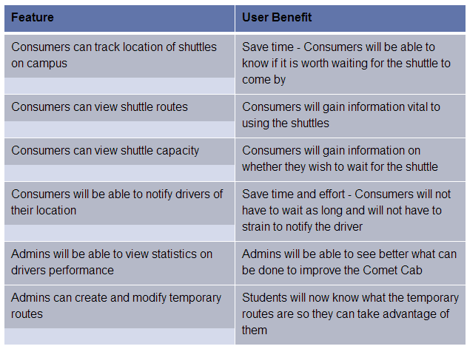
Features List

Slide 3
